Slide 1
Database Design for Hospital Management
SQL (Structured Query Language)

Slide 2
Introduction
Hospital management is a comprehensive field that focuses on efficiently overseeing the operations of healthcare facilities to ensure high-quality patient care.
It involves the strategic planning, organization, and coordination of every service in a hospital—from clinical care and nursing to administrative operations, human resources, finance, and information technology.
The goal of hospital management is to create a seamless environment where resources are optimally allocated, healthcare professionals are supported, and patient outcomes are improved.
By integrating advanced technologies, evidence-based practices, and strategic planning, hospital managers work to enhance service delivery, maintain regulatory compliance, and foster a culture of continuous improvement in an ever-evolving healthcare landscape.

Slide 3
Features
Appointment Scheduling - Allow patients to book appointments with doctors.
Doctor Availability Management – Manage doctor schedules and their availability.
Prescription Management – Track medications prescribed to patients.
Patient History – Score and display previous visits, doctor schedules, or prescription history.
Search Functionality – Implement search queries for finding specific patients, doctors, appointments, etc.
Departmental Organization – Categorize doctors and patients under specific medical departments.

Slide 4
Database
Database Schema for Hospital Management System
Tables:
Patients – Stores information about the patients.
Doctors – Stores details about the doctors.
Appointments – Tracks patient appointments with doctors.
Prescriptions – Stores prescriptions for patients.
Departments – Stores departments like cardiology, neurology, etc.
Medications – Stores information about medicines prescribed.

Slide 5
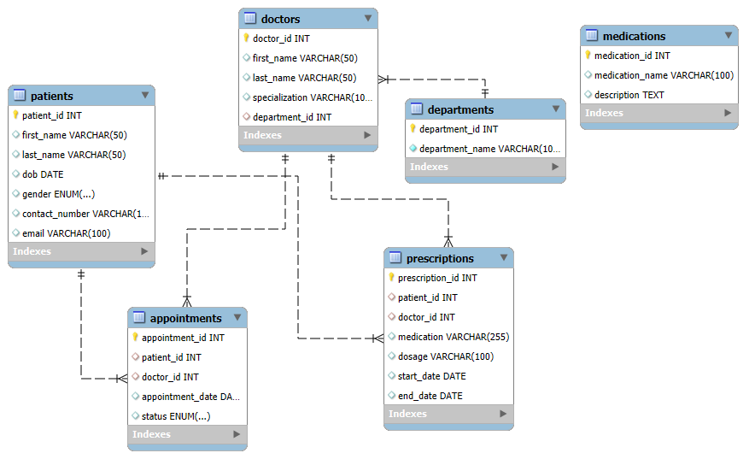
ER Diagram

Slide 6

Create Database
Create database Hospital_Management;
use Hospital_Management
Create table for departments
Create table departments (
department_id int primary key auto_increment,
department_name varchar(100) not null
);
desc departments;
output

Slide 7
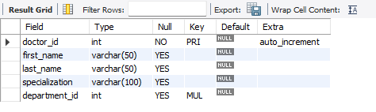
Creating table for doctors
Create table doctors (
doctor_id int primary key auto_increment,
first_name varchar(50),
last_name varchar(50),
specialization varchar(100),
department_id int,
foreign key (department_id) references departments(department_id)
);
desc doctors;
Output

Slide 8
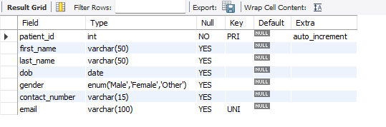
Create table for patients
Create table patients (
patient_id int primary key auto_increment,
first_name varchar(50),
last_name varchar(50),
dob date,
gender enum('male', 'female', 'other'),
contact_number varchar(15),
email varchar(100) unique);
desc patients;
output

Slide 9
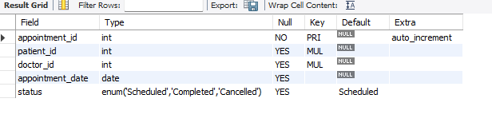
Create table for appointment
Create table appointments (
appointment_id int primary key auto_increment,
patient_id int,
doctor_id int,
appointment_date date,
status enum('scheduled', 'completed', 'cancelled') default 'scheduled',
foreign key (patient_id) references patients(patient_id),
foreign key (doctor_id) references doctors(doctor_id));
desc appointments;
output

Slide 10
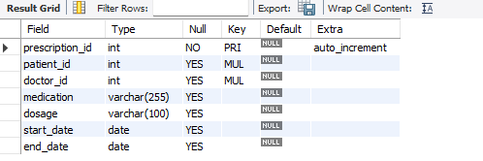
Create table for prescriptions
Create table prescriptions (
prescription_id int primary key auto_increment,
patient_id int, doctor_id int,
medication varchar(255),
dosage varchar(100),
start_date date,
end_date date,
foreign key (patient_id) references patients(patient_id),
foreign key (doctor_id) references doctors(doctor_id));
desc prescriptions;
output

Slide 11
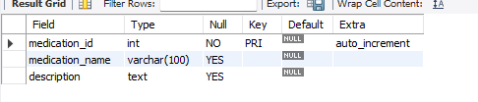
Create table for medications
Create table medications (
medication_id int primary key auto_increment,
medication_name varchar(100),
description text
);
desc prescriptions;
output

Slide 12
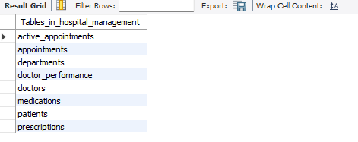
Show All Existing Tables
show tables;
output

Slide 13
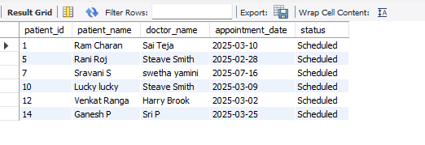
Get a list of patients who scheduled their appointments
Select p.patient_id,
concat(p.first_name,' ',p.last_name) Patient_Name,
concat(d.first_name,' ',d.last_name) Doctor_Name,
a.appointment_date, a.status
from appointments a
join patients p on a.patient_id = p.patient_id
join doctors d on a.doctor_id = d.doctor_id;
Output

Slide 14
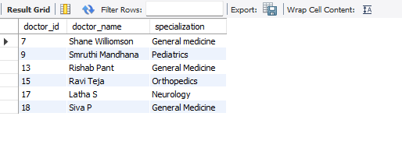
List doctors who have not had any appointments in the past year.
select doctor_id, concat(first_name, ' ', last_name) as doctor_name, specialization
from doctors
where doctor_id not in (
select distinct doctor_id
from appointments
where appointment_date >= date_sub(curdate(), interval 1 year)
);
Output

Slide 15
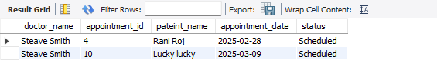
Find all appointments for a specific doctor with patient names.
select concat(d.first_name,' ',d.last_name) doctor_name,
appointment_id,
concat(p.first_name,' ',p.last_name) pateint_name, a.appointment_date, a.status
from appointments a
join patients p on a.patient_id = p.patient_id
join doctors d on a.doctor_id= d.doctor_idwhere a.doctor_id = 4;
Output

Slide 16
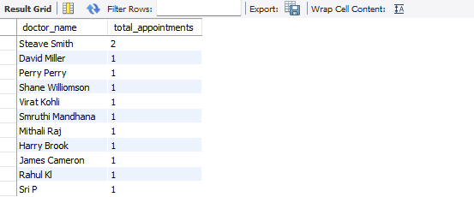
Count the number of appointments per doctor.
select concat(d.first_name,' ',d.last_name) doctor_name,
count(*) as total_appointments
from appointments a
join doctors d on a.doctor_id=d.doctor_id
group by d.doctor_id;
Output

Slide 17
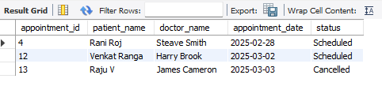
Retrieve upcoming appointments within the next 7 days.
select a.appointment_id,concat(p.first_name,' ',p.last_name) patient_name,concat(d.first_name,' ',d.last_name) doctor_name,a.appointment_date,a.status
from appointments a
join patients p on a.patient_id=p.patient_id
join doctors d on a.doctor_id=d.doctor_id
where a.appointment_date between curdate() and date_add(curdate(), interval 7 day);
Output

Slide 18
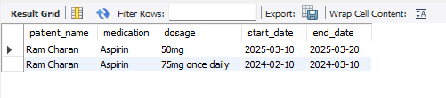
Get prescriptions for a particular patient.
select concat(p.first_name,' ', p.last_name) patient_name, pr.medication, pr.dosage, pr.start_date, pr.end_date
from prescriptions pr
join patients p on pr.patient_id = p.patient_id
where p.patient_id = 1;
Output

Slide 19
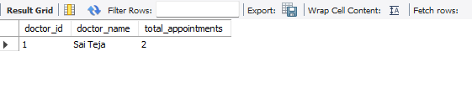
Find the busiest doctor (doctor with most appointments).
select d.doctor_id, concat(d.first_name, ' ', d.last_name) as doctor_name, count(a.appointment_id) as total_appointments
from doctors d
join appointments a on d.doctor_id = a.doctor_id
group by d.doctor_id, doctor_name
order by total_appointments desc
limit 1;
Output

Slide 20

Get all patients who have an appointment with a specific doctor (e.g., doctor_id = 2)
select distinct p.patient_id,
concat(p.first_name, ' ', p.last_name) as patient_name
from patients p
join appointments a on p.patient_id = a.patient_id
where a.doctor_id = 2;
Output

Slide 21
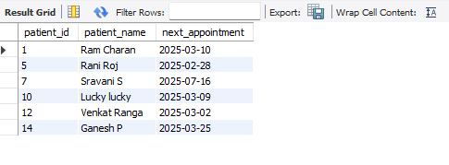
Find the Next Appointment for Each Patient.
select a.patient_id,
concat(p.first_name, ' ', p.last_name) as patient_name,
min(a.appointment_date) as next_appointment
from appointments a
join patients p on a.patient_id = p.patient_id
where a.status = 'scheduled’
group by a.patient_id, patient_name;
Output

Slide 22
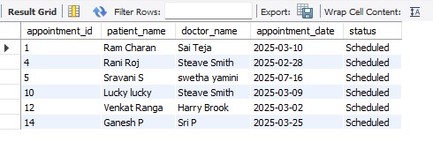
Create a View for Active Appointments.
create view active_appointments as
select a.appointment_id,
concat(p.first_name, ' ', p.last_name) as patient_name,
concat(d.first_name, ' ', d.last_name) as doctor_name,
a.appointment_date, a.status from appointments a
join patients p on a.patient_id = p.patient_id
join doctors d on a.doctor_id = d.doctor_id
where a.status = 'scheduled’;
Select * from active_appoitments;
Output

Slide 23

Stored Procedure to Get Appointments for a Specific Doctor.
delimiter //
create procedure getdoctorappointments(in doctorid int)
begin
select a.appointment_id,
concat(p.first_name, ' ', p.last_name) as patient_name,
a.appointment_date, a.status
from appointments a
join patients p on a.patient_id = p.patient_id
where a.doctor_id = doctorid;
end //
delimiter ;
call getdoctorappointments(2);
Output

Slide 24
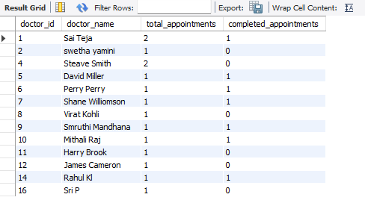
Create a View for doctor performance.
Output
create view doctor_performance as
select d.doctor_id,
concat(d.first_name, ' ', d.last_name) as
doctor_name,
count(a.appointment_id) as total_appointments,
sum(case when a.status = 'completed' then 1 else 0 end) as completed_appointments
from doctors d
left join appointments a
on d.doctor_id = a.doctor_id
group by d.doctor_id, doctor_name
Having total_appointment>=1;
select * from doctor_performance;

Slide 25
Stored Procedure to Get Patient History .
delimiter //
create procedure getpatienthistory(in pid int)
begin
Select p.patient_id,
concat(p.first_name, ' ', p.last_name) as patient_name,
a.appointment_id, a.appointment_date, a.status, pr.prescription_id, pr.medication, pr.dosage, pr.start_date,pr.end_date
from patients p
left join appointments a on p.patient_id = a.patient_id
left join prescriptions pr on p.patient_id = pr.patient_id where p.patient_id = pid;
end//
delimiter ;
call getpatienthistory(2);
Output

Slide 26
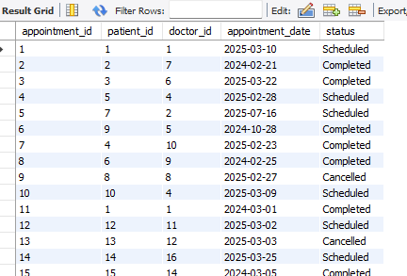
Stored Procedure to UpdateAppointmentStatus
delimiter //
create procedure updateappointmentstatus
(in aid int, in newstatus varchar(20))
begin
update appointments set status = newstatus where appointment_id = aid;
end //
delimiter ;
call updateappointmentstatus(7, 'completed’);
select* from appointments;

Slide 27
Conclusion
A well-designed Hospital Management System provides a robust, scalable solution that streamlines all aspects of healthcare administration—from patient registration and appointment scheduling to prescription management and detailed reporting.
By leveraging the power of SQL with well-defined table structures, foreign key constraints, views, and stored procedures, hospitals can ensure data integrity, enhance operational efficiency, and improve the quality of patient care.
This comprehensive system not only simplifies day-to-day administrative tasks but also empowers healthcare professionals with actionable insights, facilitating informed decision-making and ultimately leading to better healthcare outcomes.

Slide 28
Final Note
This Hospital Management System (HMS) project represents a comprehensive, database-driven solution designed to streamline hospital operations and improve patient care.
By integrating essential modules—such as patient registration, doctor and staff management, appointment scheduling, and prescription tracking—the system facilitates efficient data storage, retrieval, and reporting.

Slide 29
Thank You

